Slide 1
Advanced Encryption Standard
Harsimrat Sudeep

Slide 2
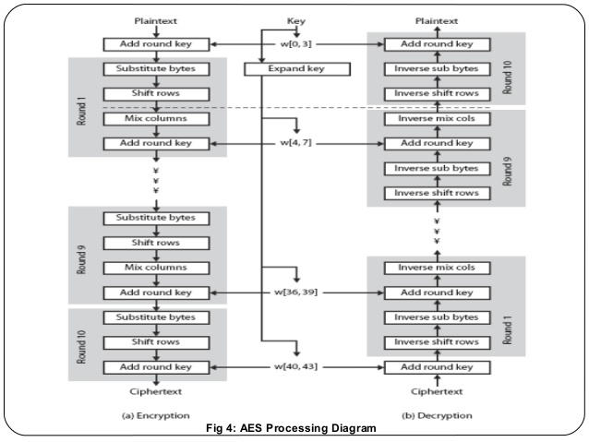

Slide 3
AES Steps
Convert plaintext to matrix
4 parts of AES
Substitution Block
Shift Rows
Mix Columns
Add Round Key
Key Expansion

Slide 4
Convert plaintext to matrix
Input block:
0
1
2
3
4
5
6
7
8
9
10
11
12
13
14
15
=
0 | 4 | 8 | 12
1 | 5 | 9 | 13
2 | 6 | 10 | 14
3 | 7 | 11 | 15

Slide 5
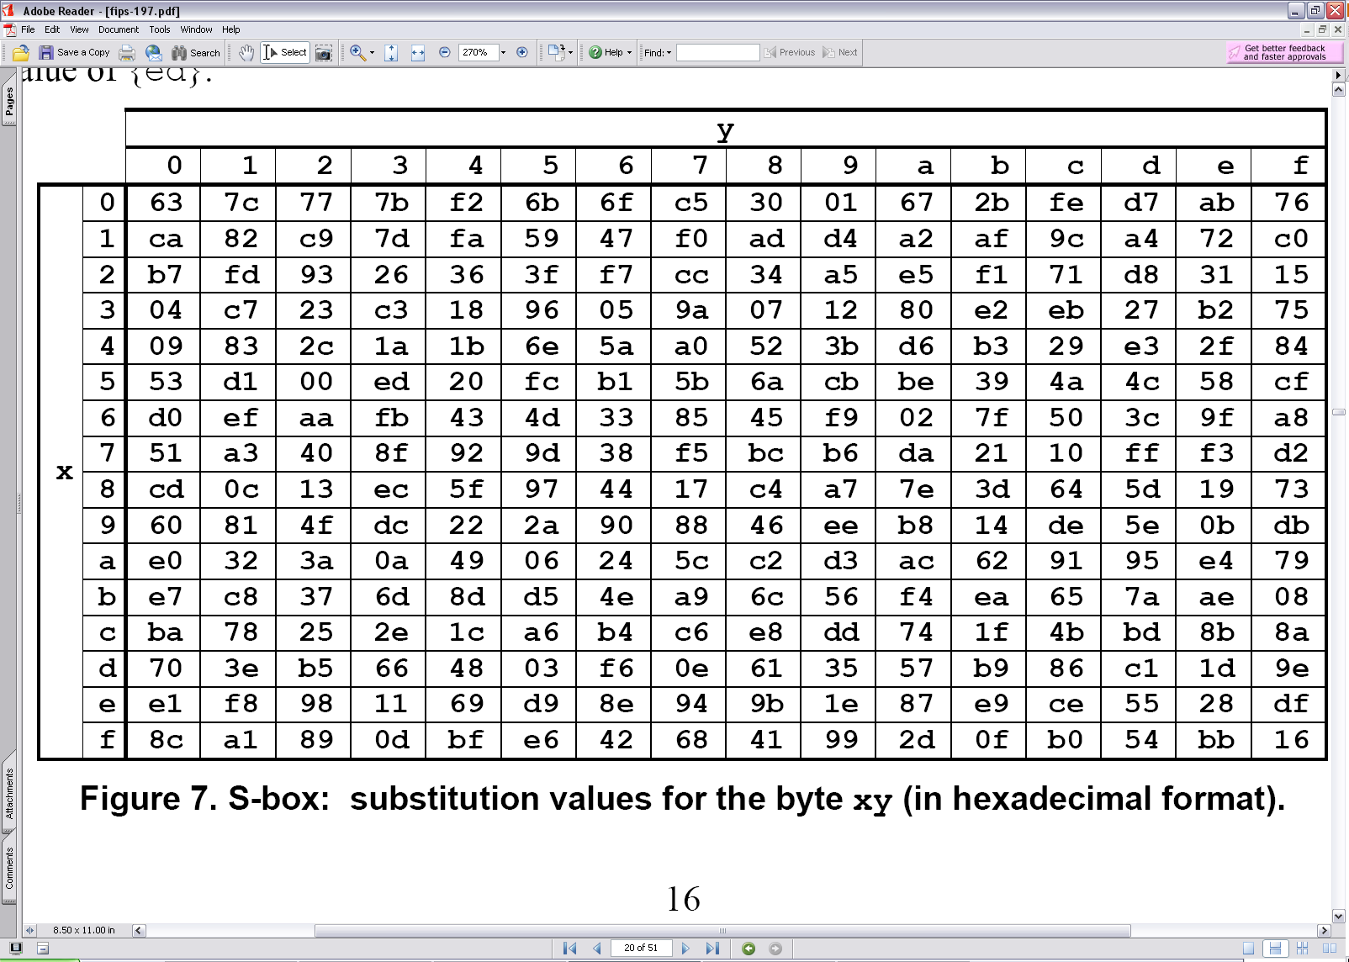
Substitution Block
Replace each element i.e. 1 byte of matrix with its corresponding value from the S-Box
00 | 44 | 88 | CC
11 | 55 | 99 | DD
22 | 66 | AA | EE
33 | 77 | BB | FF

Slide 6
Shift Rows
Shift rows to left by their row number in cyclic order
0 | 4 | 8 | 12
1 | 5 | 9 | 13
2 | 6 | 10 | 14
3 | 7 | 11 | 15
0 | 4 | 8 | 12
5 | 9 | 13 | 1
10 | 14 | 2 | 6
15 | 3 | 7 | 11

Slide 7
Mix Column
Combine elements in one column to get new column
2 | 3 | 1 | 1
1 | 2 | 3 | 1
1 | 1 | 2 | 3
3 | 1 | 1 | 2
S_{0,0} | S_{0,1} | S_{0,2} | S_{0,3}
S_{1,0} | S_{1,1} | S_{1,2} | S_{1,3}
S_{2,0} | S_{2,1} | S_{2,2} | S_{2,3}
S_{3,0} | S_{3,1} | S_{3,2} | S_{3,3}
S’_{0,0} | S’_{0,1} | S’_{0,2} | S’_{0,3}
S’_{1,0} | S’_{1,1} | S’_{1,2} | S’_{1,3}
S’_{2,0} | S’_{2,1} | S’_{2,2} | S’_{2,3}
S’_{3,0} | S’_{3,1} | S’_{3,2} | S’_{3,3}
X
=

Slide 8
Add Round Key
XOR each byte of the round key with its corresponding byte in the matrix
K_{0,0} | K_{0,1} | K_{0,2} | K_{0,3}
K_{1,0} | K_{1,1} | K_{1,2} | K_{1,3}
K_{2,0} | K_{2,1} | K_{2,2} | K_{2,3}
K_{3,0} | K_{3,1} | K_{3,2} | K_{3,3}
S_{0,0} | S_{0,1} | S_{0,2} | S_{0,3}
S_{1,0} | S_{1,1} | S_{1,2} | S_{1,3}
S_{2,0} | S_{2,1} | S_{2,2} | S_{2,3}
S_{3,0} | S_{3,1} | S_{3,2} | S_{3,3}
S’_{0,0} | S’_{0,1} | S’_{0,2} | S’_{0,3}
S’_{1,0} | S’_{1,1} | S’_{1,2} | S’_{1,3}
S’_{2,0} | S’_{2,1} | S’_{2,2} | S’_{2,3}
S’_{3,0} | S’_{3,1} | S’_{3,2} | S’_{3,3}
⊕
=

Slide 9
Key Expansion
B₀ | B₁ | B₂ | B₃
B₁ | B₂ | B₃ | B₀
K_{0,0} | K_{0,1} | K_{0,2} | K_{0,3}
K_{1,0} | K_{1,1} | K_{1,2} | K_{1,3}
K_{2,0} | K_{2,1} | K_{2,2} | K_{2,3}
K_{3,0} | K_{3,1} | K_{3,2} | K_{3,3}
g
w₀ | w₁ | w₂ | w₃
S
S
S
S
⊕
⊕
⊕
⊕
B’₁ | B’₂ | B’₃ | B’₀
w₀ | w₁ | w₂ | w₃
w₄ | w₅ | w₆ | w₇
⊕
RC_{j}
B’₁ | B’₂ | B’₃ | B’₀

